Slide 1
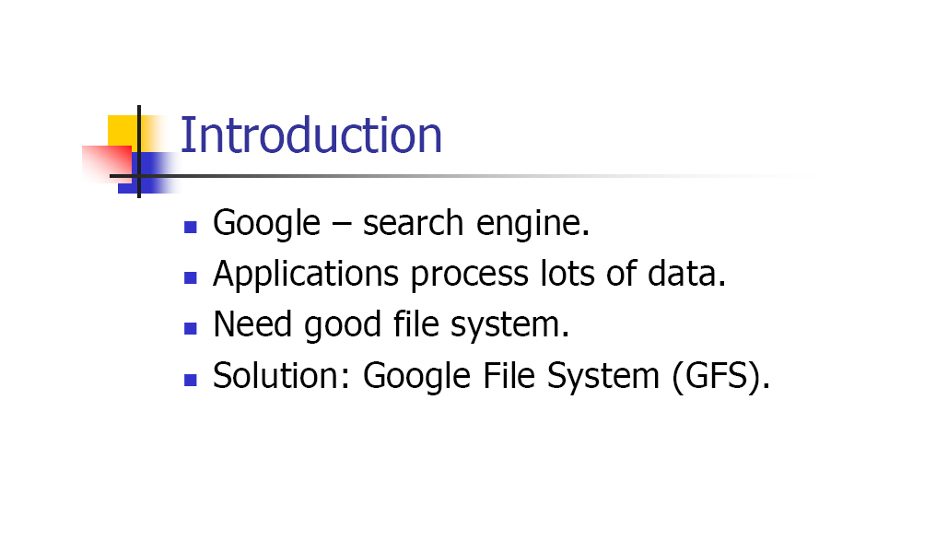
Google file System

Slide 2
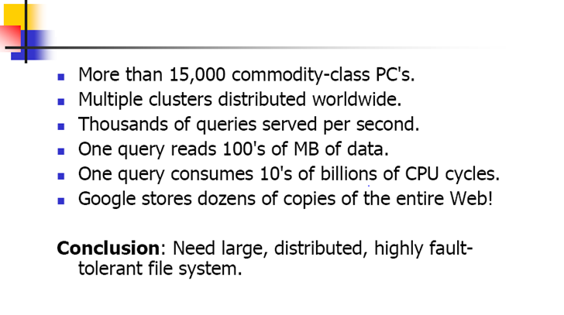
Google file System

Slide 3
Google file system (GFS)
Google File System, a scalable distributed file system for large distributed data-intensive applications.
Google File System (GFS) to meet the rapidly growing demands of Google’s data processing needs.
GFS shares many of the same goals as other distributed file systems such as performance, scalability, reliability, and availability.
GFS provides a familiar file system interface.
Files are organized hierarchically in directories and identified by pathnames.
Support the usual operations to create, delete, open, close, read, and write files.

Slide 4
GFS
Small as well as multi-GB files are common.
Each file typically contains many application objects such as web documents.
GFS provides an atomic append operation called record append. In a traditional write, the client specifies the offset at which data is to be written.
Concurrent writes to the same region are not serializable.
GFS has snapshot and record append operations.

Slide 5
GFS (snapshot and record append)
The snapshot operation makes a copy of a file or a directory.
Record append allows multiple clients to append data to the same file concurrently while guaranteeing the atomicity of each individual client’s append.
It is useful for implementing multi-way merge results.
GFS consist of two kinds of reads: large streaming reads and small random reads.
In large streaming reads, individual operations typically read hundreds of KBs, more commonly 1 MB or more.
A small random read typically reads a few KBs at some arbitrary offset.

Slide 6
Common Goals of GFS and most Distributed File Systems
Performance
Reliability
Scalability
Availability

Slide 7
Other GFS Concepts
Component failures are the norm rather than the exception.
File System consists of hundreds or even thousands of storage machines built from inexpensive commodity parts.
Files are Huge. Multi-GB Files are common.
Each file typically contains many application objects such as web documents.
Append, Append, Append.
Most files are mutated by appending new data rather than overwriting
existing data.
Co-Designing
Co-designing applications and file system API benefits overall system by increasing flexibility.

Slide 8
Other GFS Concepts
Why assume hardware failure is the norm?
It is cheaper to assume common failure on poor hardware and account for it, rather than invest in expensive hardware and still experience occasional failure.
The amount of layers in a distributed system (network, disk, memory, physical connections, power, OS, application) mean failure on any could contribute to data corruption.

Slide 9
GFS Assumptions
System built from inexpensive commodity components that fail
Modest number of files – expect few million and > 100MB size. Did not optimize for smaller files.
2 kinds of reads – :
large streaming read (1MB)
small random reads (batch and sort)
High sustained bandwidth chosen over low latency

Slide 10
GFS Interface
GFS – familiar file system interface
Files organized hierarchically in directories, path names
Create, delete, open, close, read, write operations
Snapshot and record append (allows multiple clients to append simultaneously - atomic)

Slide 11
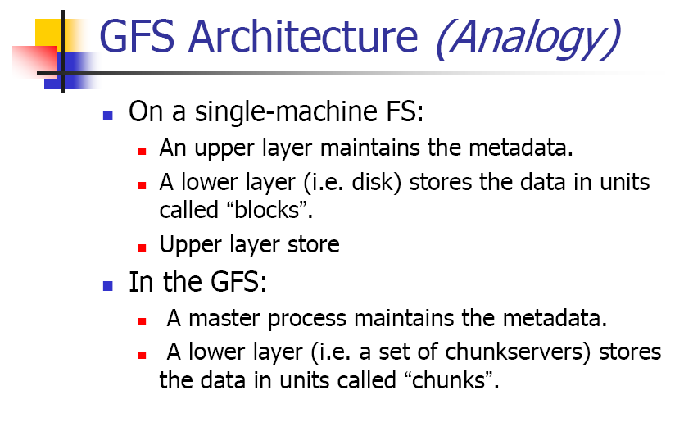
GFS Architecture

Slide 12
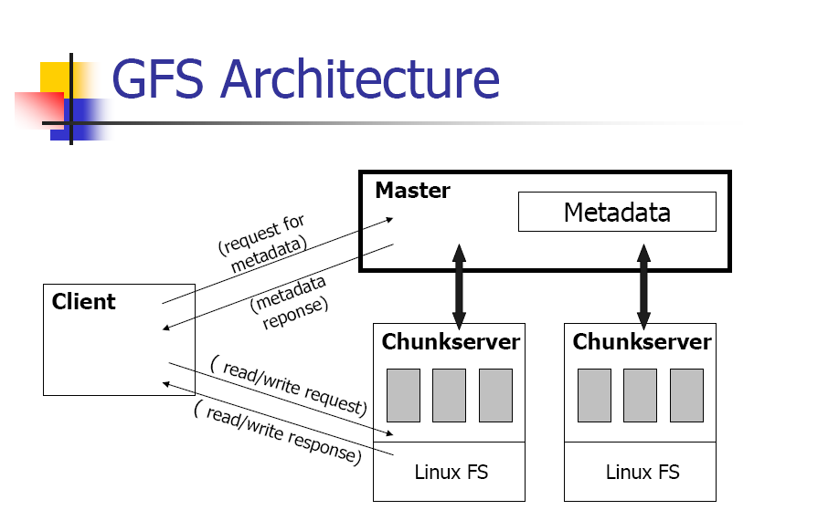
GFS Architecture

Slide 13
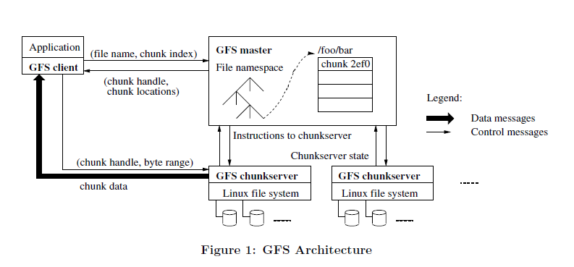
GFS Architecture

Slide 14
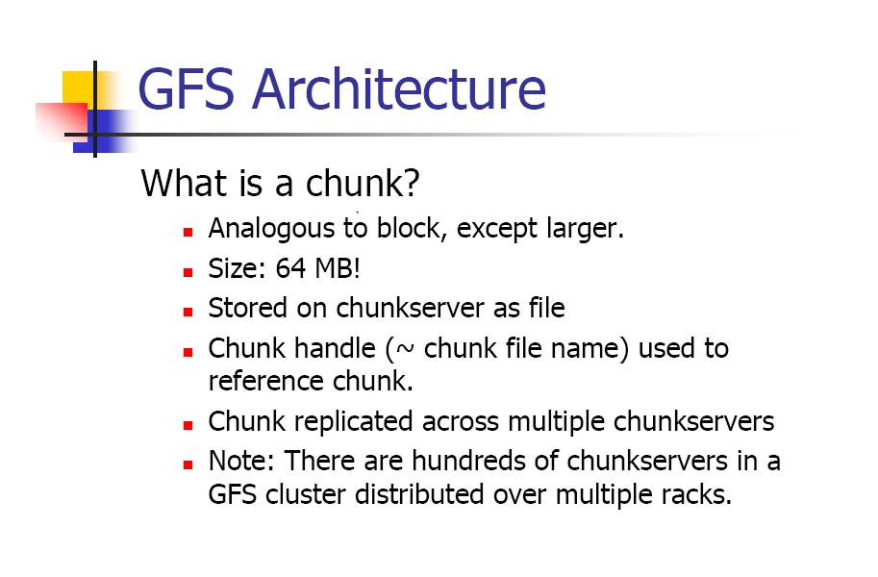
Chunk

Slide 15
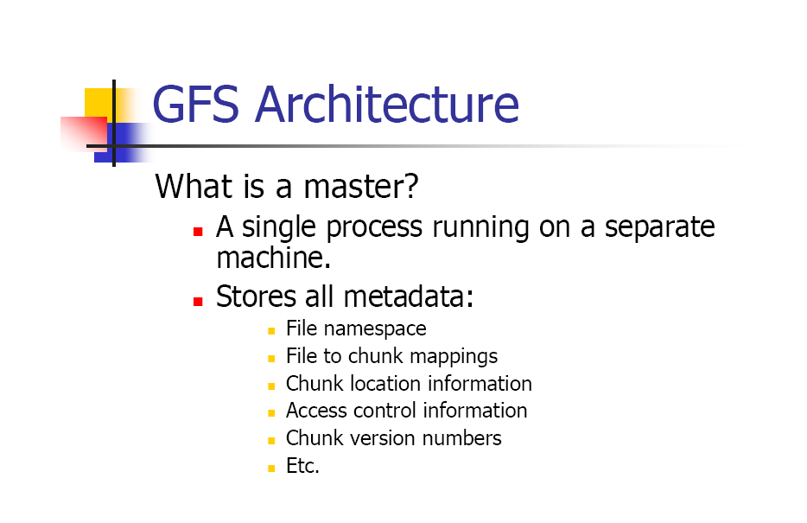

Slide 16
GFS Architecture
A GFS cluster consists of a single master and multiple chunk-servers and is accessed by multiple clients, Each of these is typically a commodity Linux machine.
It is easy to run both a chunk-server and a client on the same machine.
As long as machine resources permit, it is possible to run flaky application code is acceptable.

Slide 17
GFS Architecture
Files are divided into fixed-size chunks.
Each chunk is identified by an immutable and globally unique 64 bit chunk assigned by the master at the time of chunk creation.
Chunk-servers store chunks on local disks as Linux files, each chunk is replicated on multiple chunk-servers.
The master maintains all file system metadata. This includes the namespace, access control information, mapping from files to chunks, and the current locations of chunks.
It also controls chunk migration between chunk servers.
The master periodically communicates with each chunk server in Heart Beat messages to give it instructions and collect its state.

Slide 18
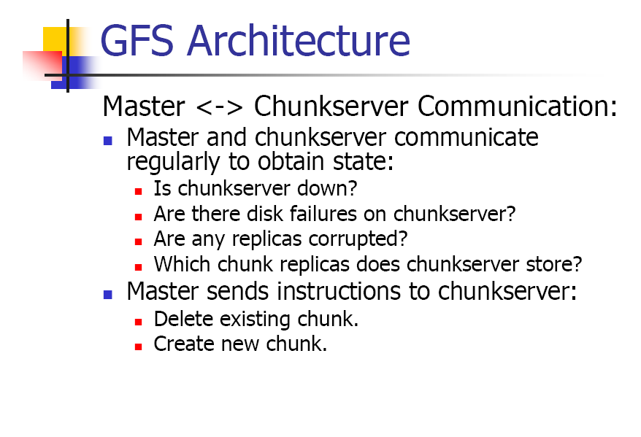

Slide 19
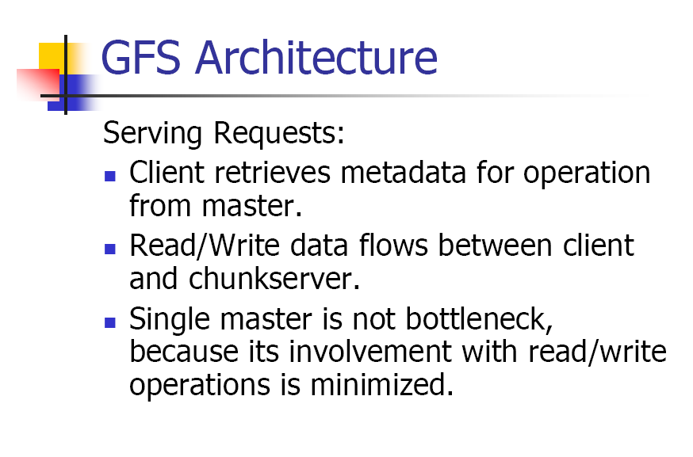

Slide 20
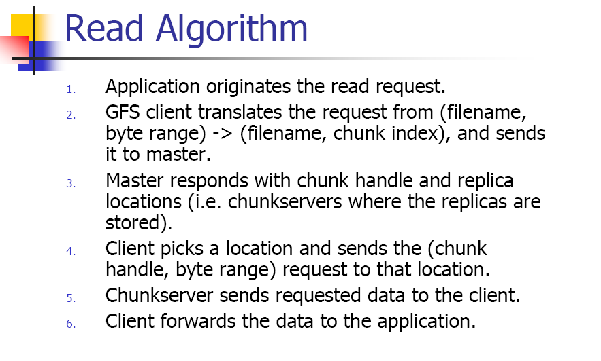

Slide 21
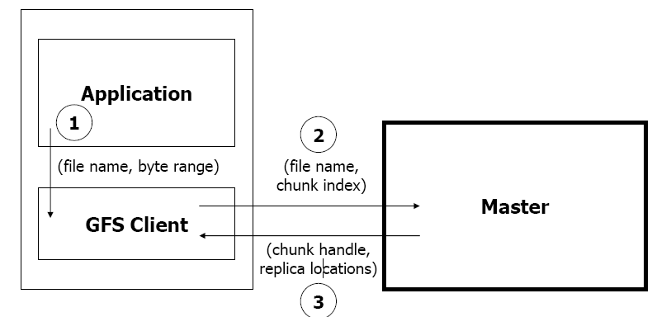
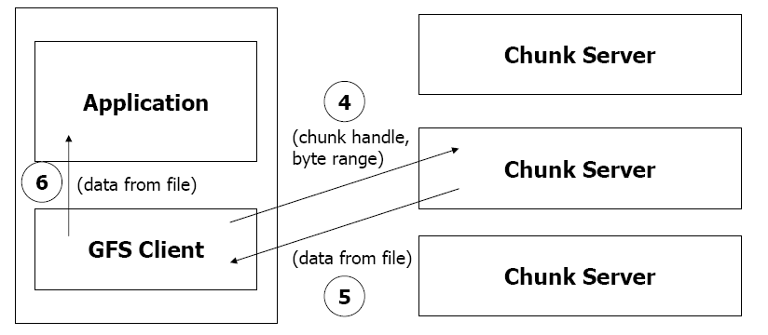

Slide 22
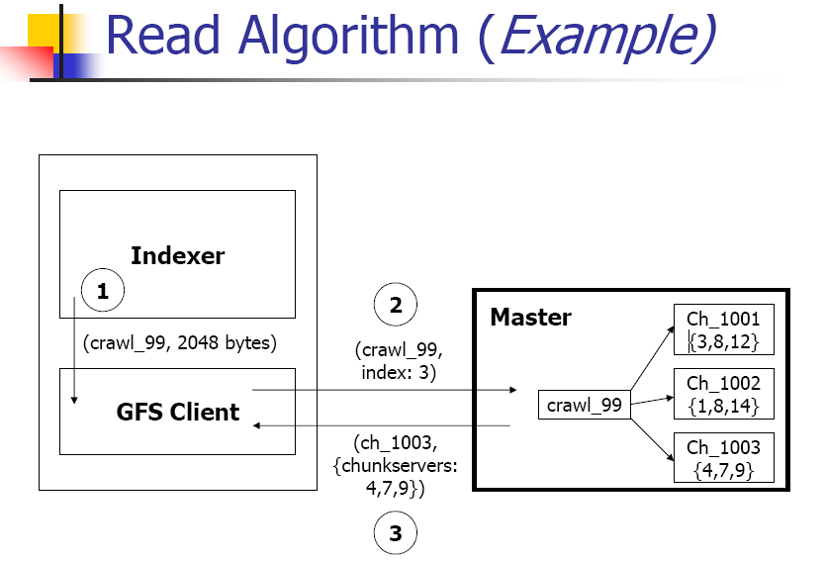
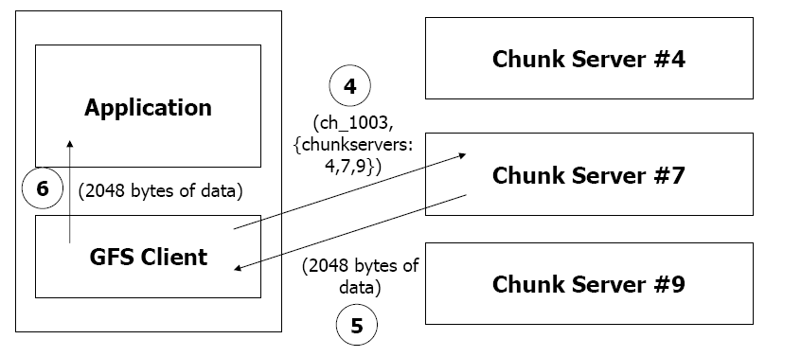

Slide 23
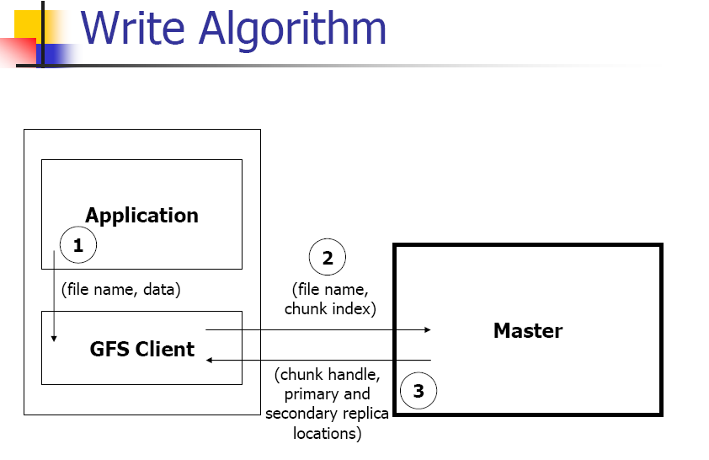

Slide 24
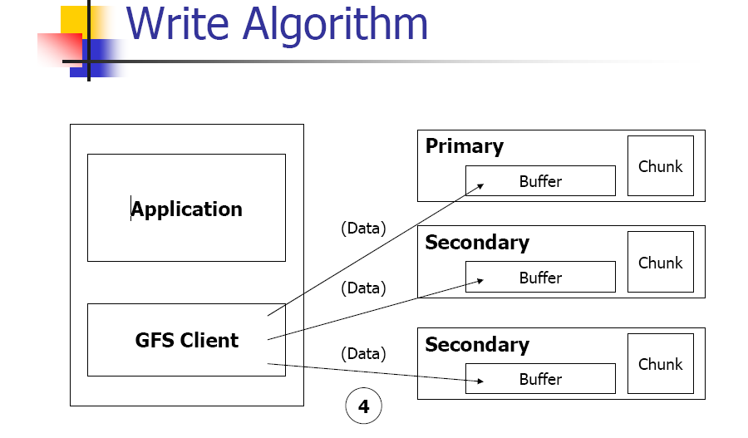

Slide 25
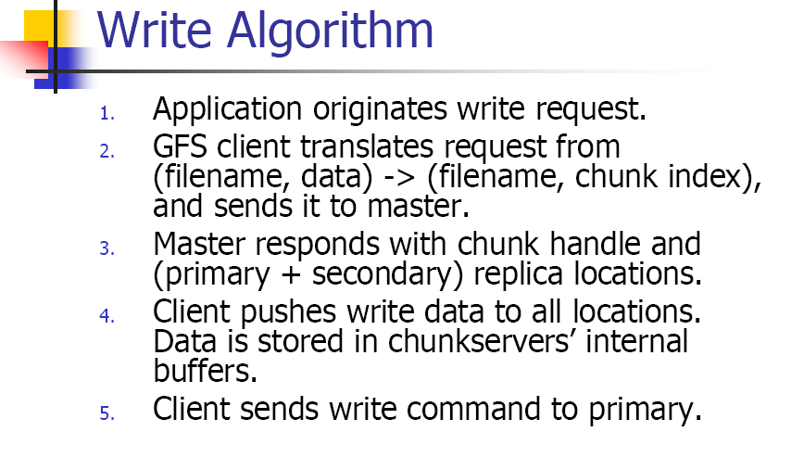

Slide 26
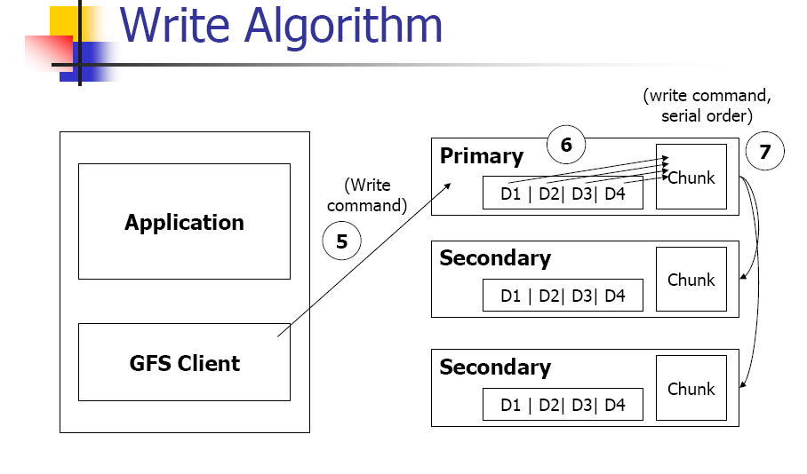

Slide 27
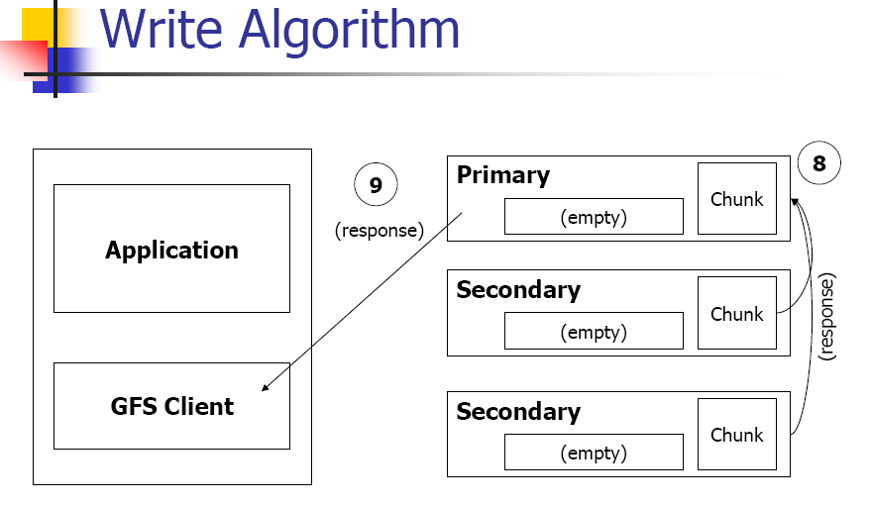

Slide 28
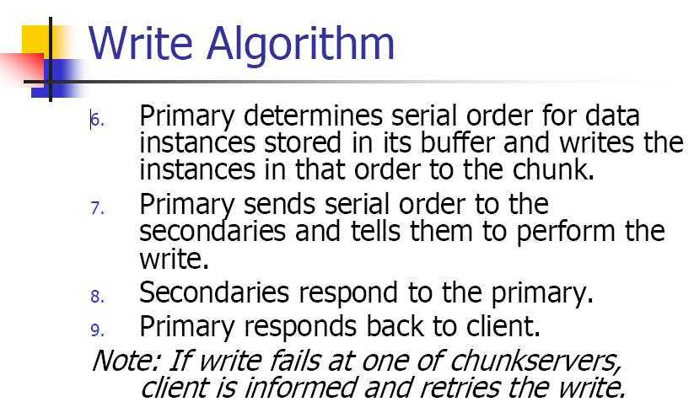

Slide 29
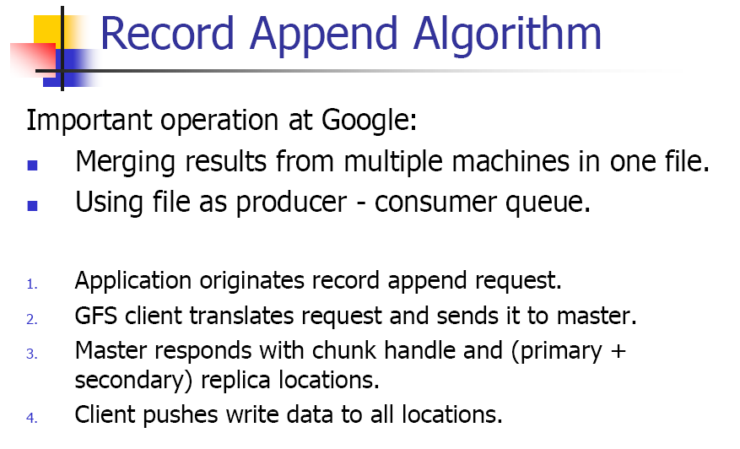

Slide 30
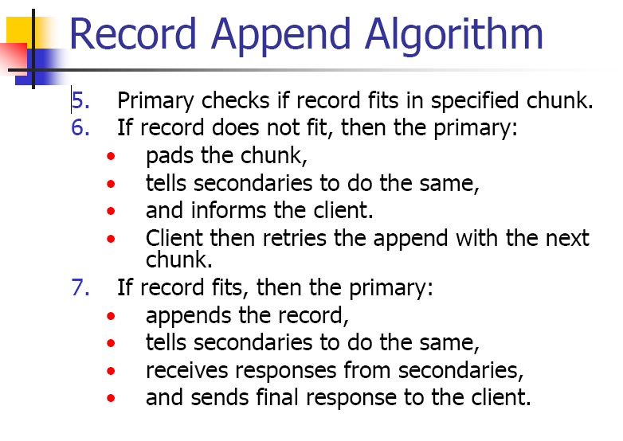

Slide 31
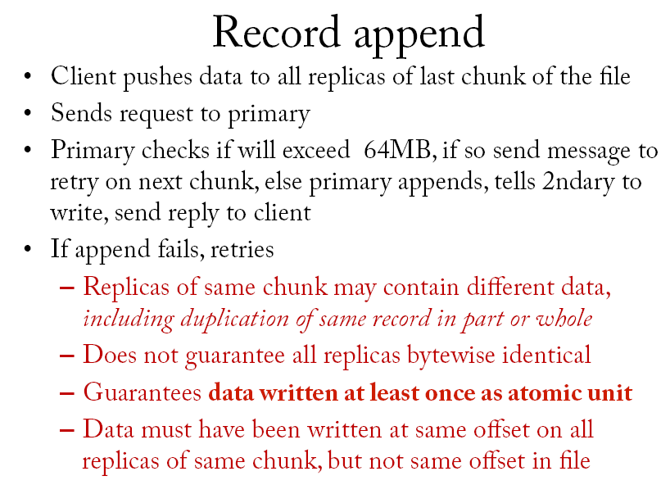

Slide 32
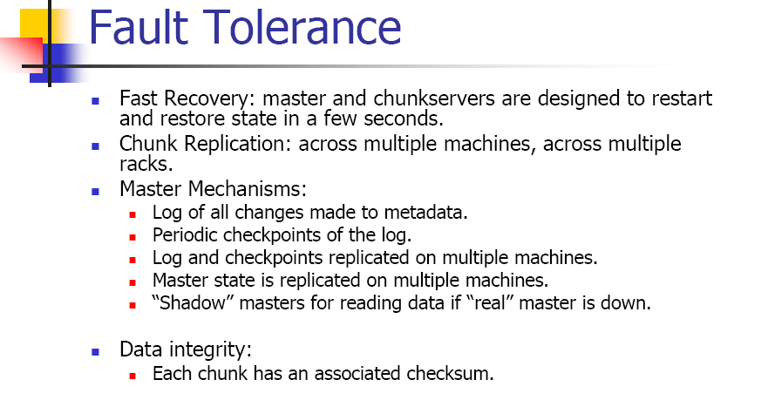
GFS is fault tolerance?

Slide 33
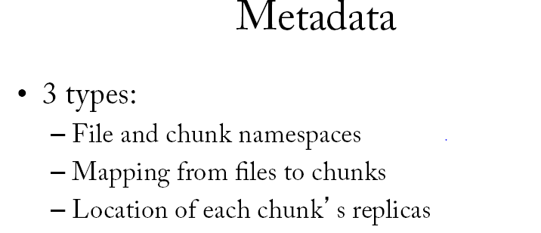

Slide 34
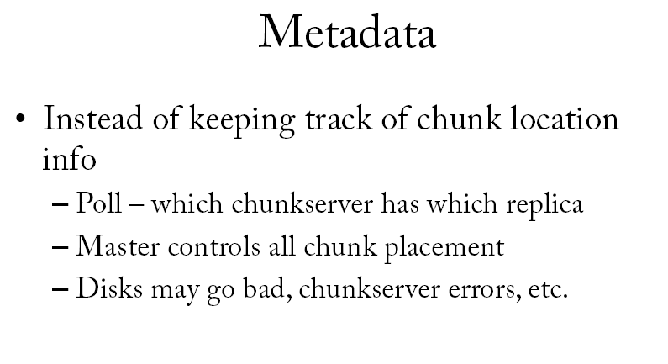

Slide 35
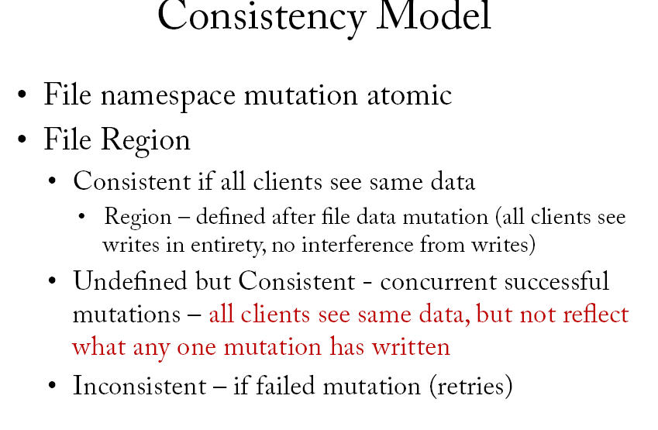
Consistency

Slide 36
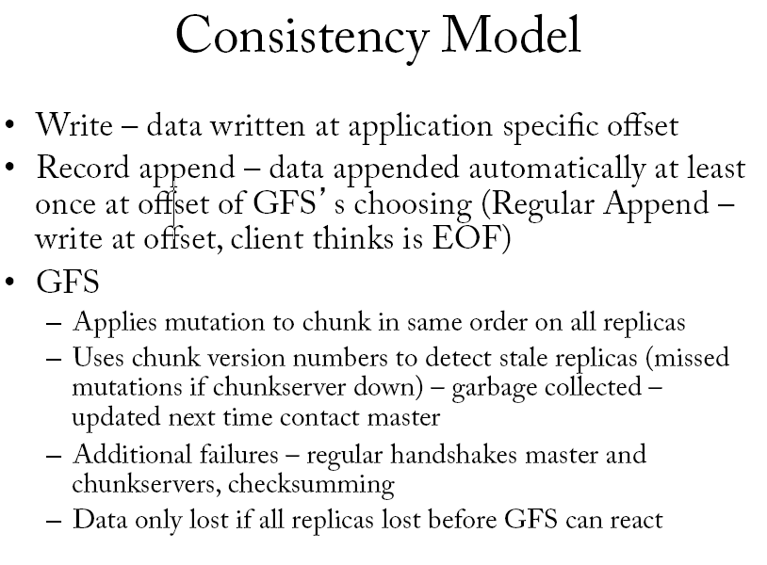
Consistency

Slide 37
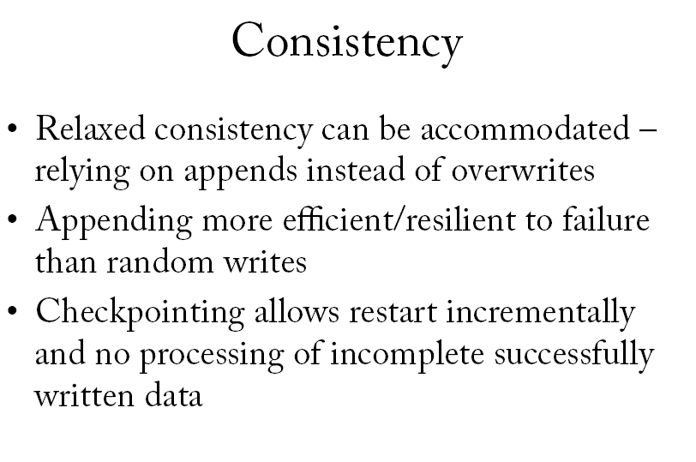

Slide 38
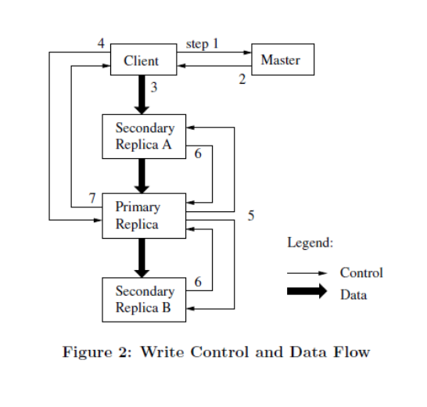
Write control and data flow

Slide 39
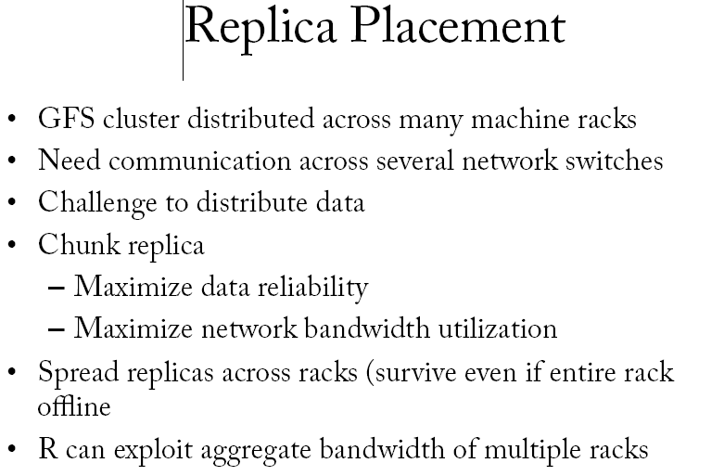
Replica placement

Slide 40
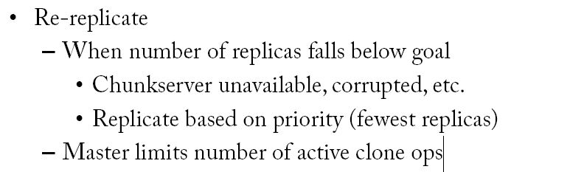
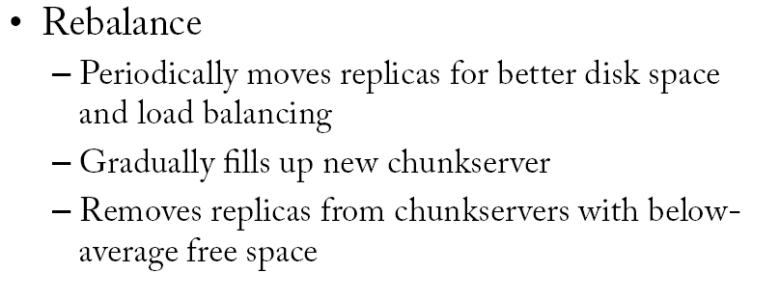
Replica placement

Slide 41
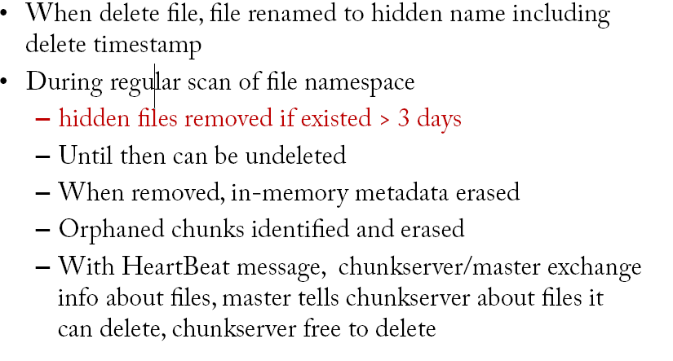
Garbage Collection

Slide 42
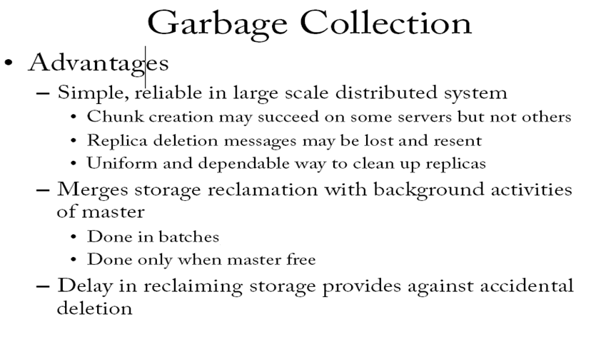

Slide 43
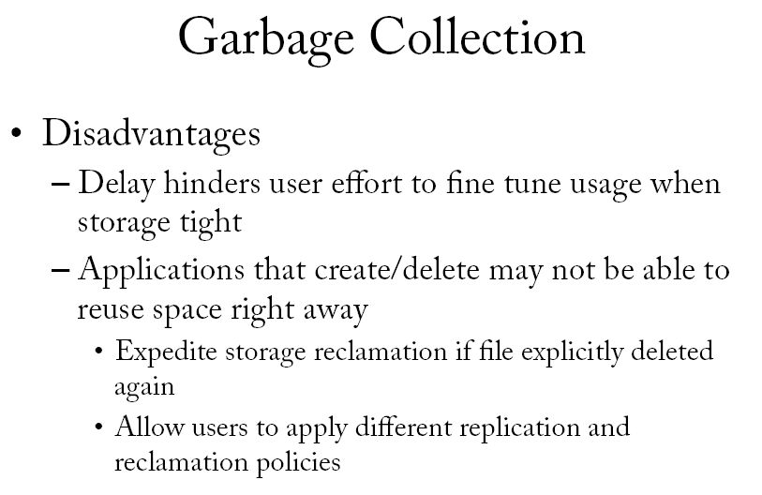

Slide 44
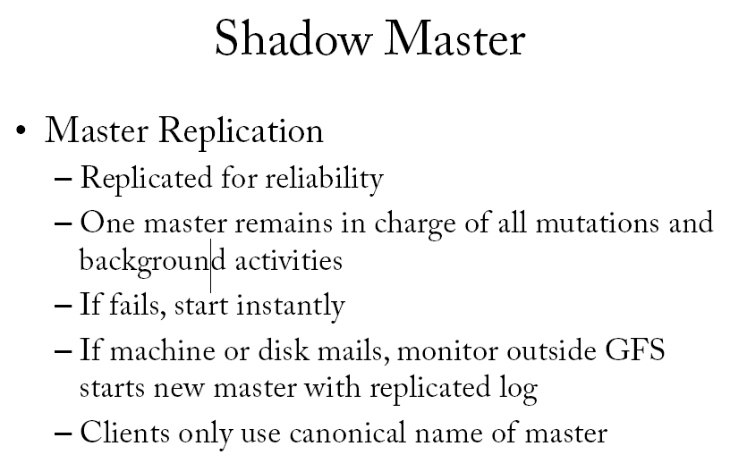

Slide 45
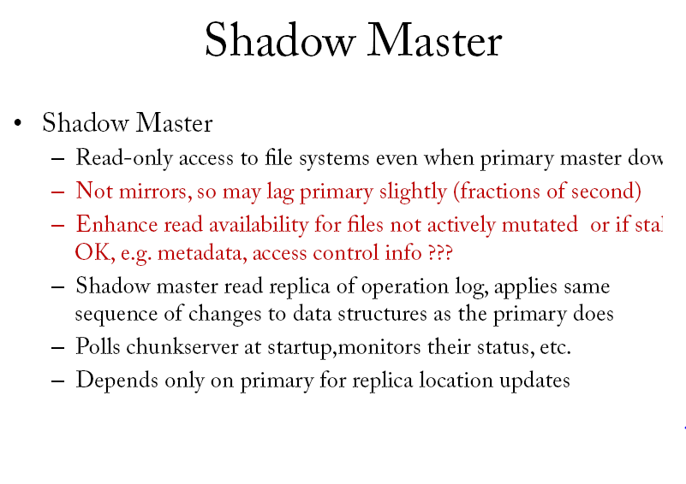

Slide 46
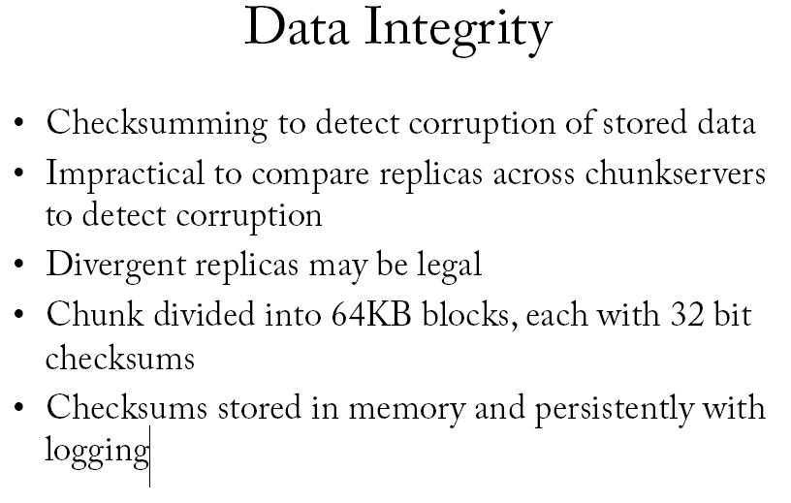

Slide 47
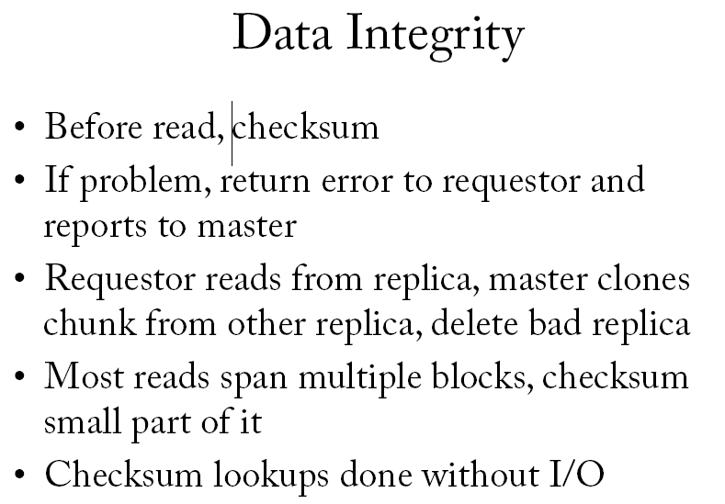

Slide 48
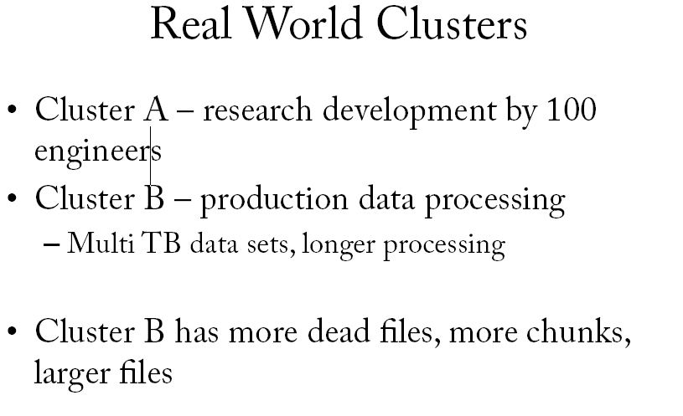

Slide 49
